Slide 1

Uber Expeditionary Analysis
Project submitted by:
G.SRINITHI
S.SRIPRIYA
G.SRINI
T.SNEKA

Slide 2
INTRODUCTION:
Uber has emerged as leading company in the provision of new transportation options within the contemporary world. Uber, then, is primarily in the business of networking, and all the company's emerging operations can be conceptualized in terms of simply providing a medium through which the relevant supply can meet up with the relevant demand. Analytics is a tremendously growing niche that people apply in their businesses to give it a boost. This is more of a data visualization project that will enhance our knowledge towards using the ggplot2 library for understanding the data and for developing an intuition for understanding the customers who avail the trips Solution to this issue is understanding what Customer segmentation (aka Market Segmentation). Customer segmentation can be explained as a game where a kid separates balls, cubes based on their shape or colors. In simple language customer segmentation is segregating customers, market on different criteria and dividing them on the basis of various characteristics.

Slide 3
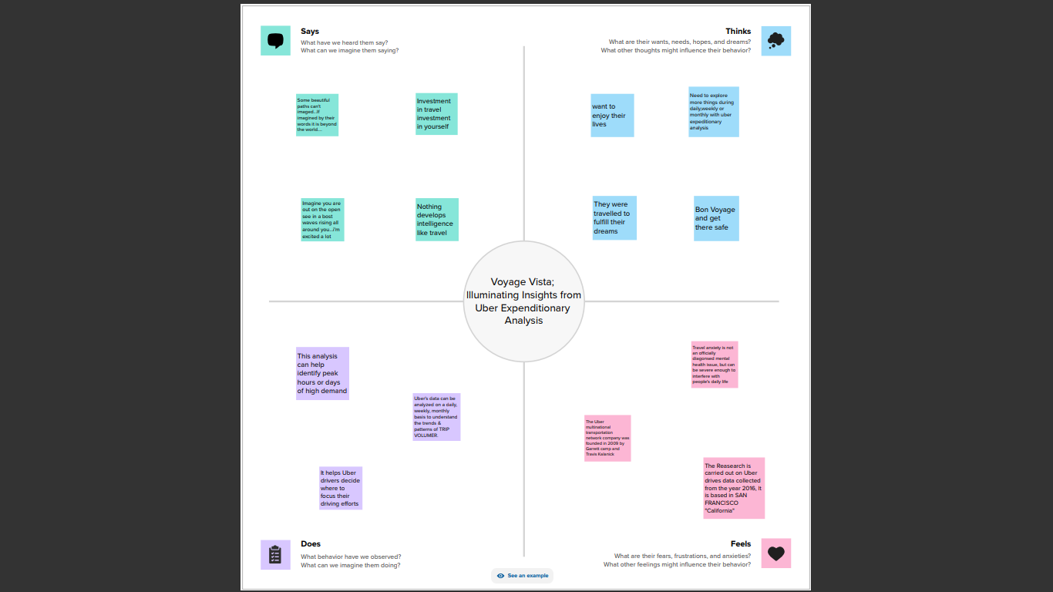
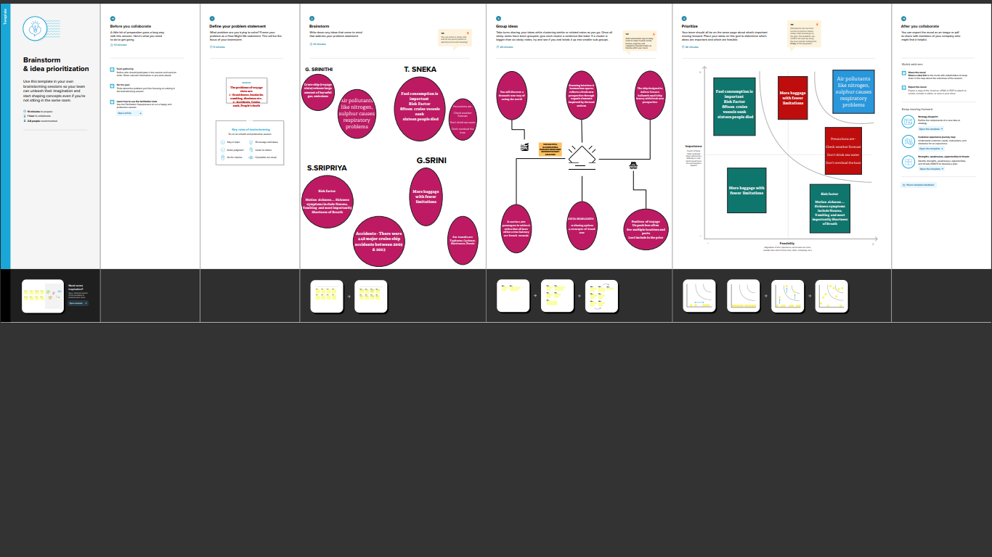
PROBLEM DEFINITION & DESIGN THINKING:
2.1 EMPATHY MAP
2.2 IDEATION & BRAINSTORMING MAP

Slide 4
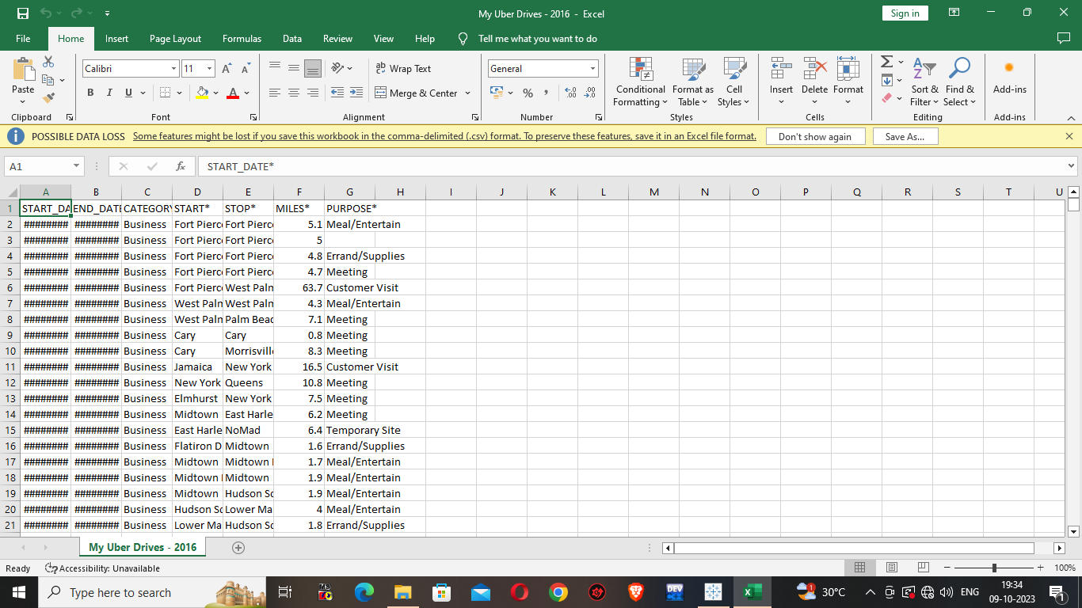
RESULT
DOWNLOADING THE DATASET
A collection of related sets of information that is composed of separate elements but can be manipulated as a unit by a computer.

Slide 5
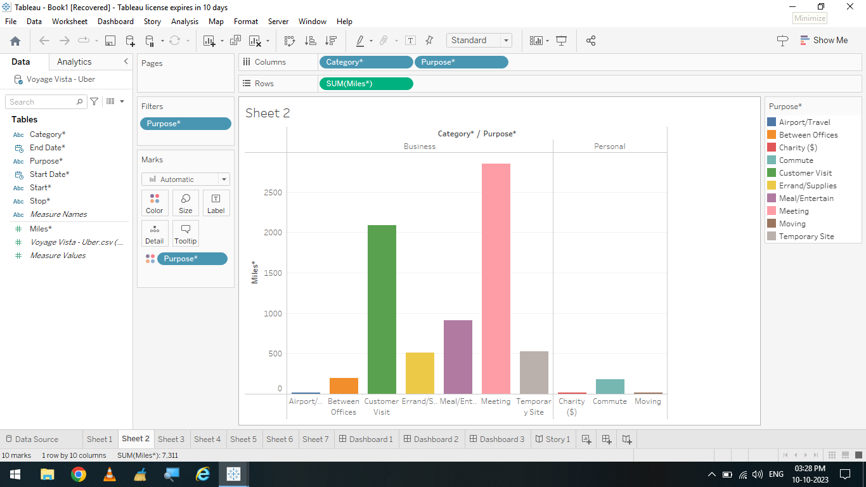
DATA VISULATION
Data visulation is the process of creating graphical representation of data in order to help people understand and explore information
ACTIVITY 1.1: Miles covered per category and Purpose Analysis

Slide 6
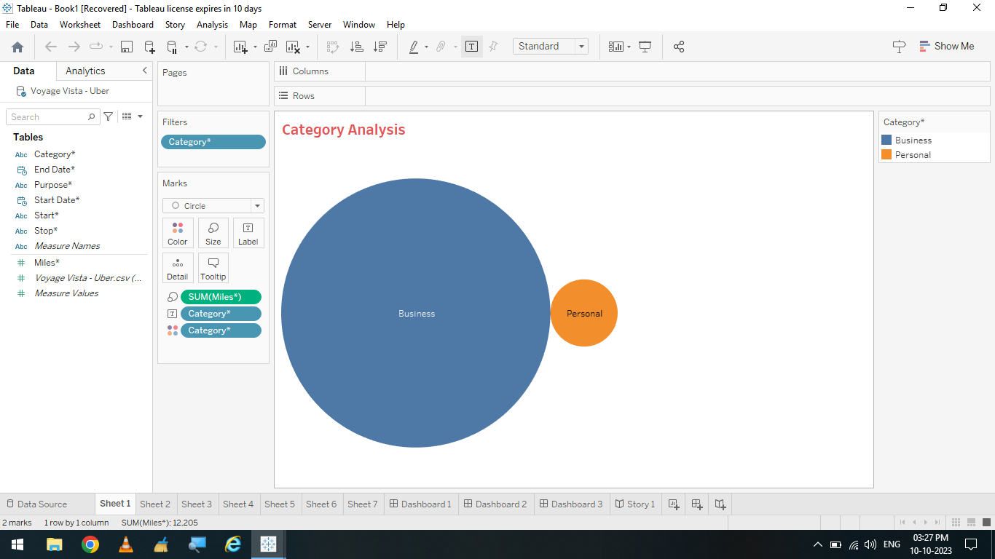
ACTIVITY 1. 2: Miles covered in Category Analysis

Slide 7
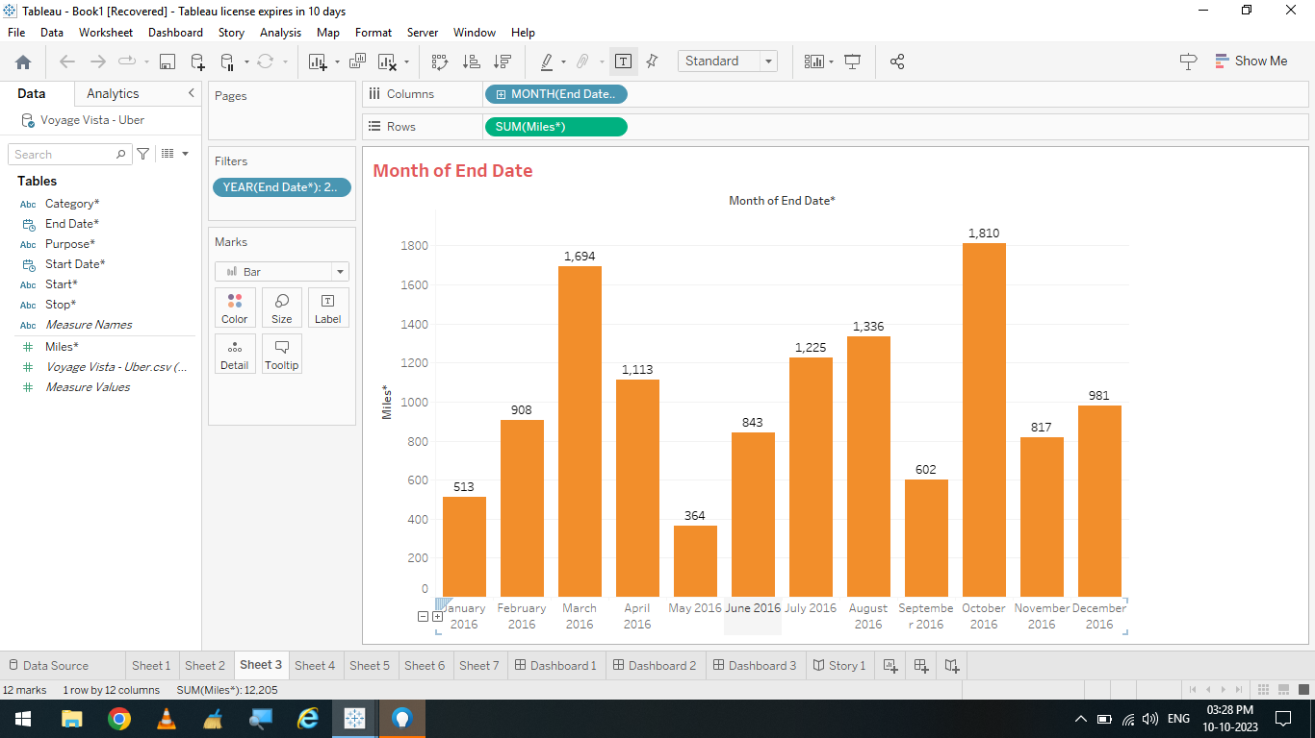
Activity 1.3: Miles covered Month of End Date

Slide 8
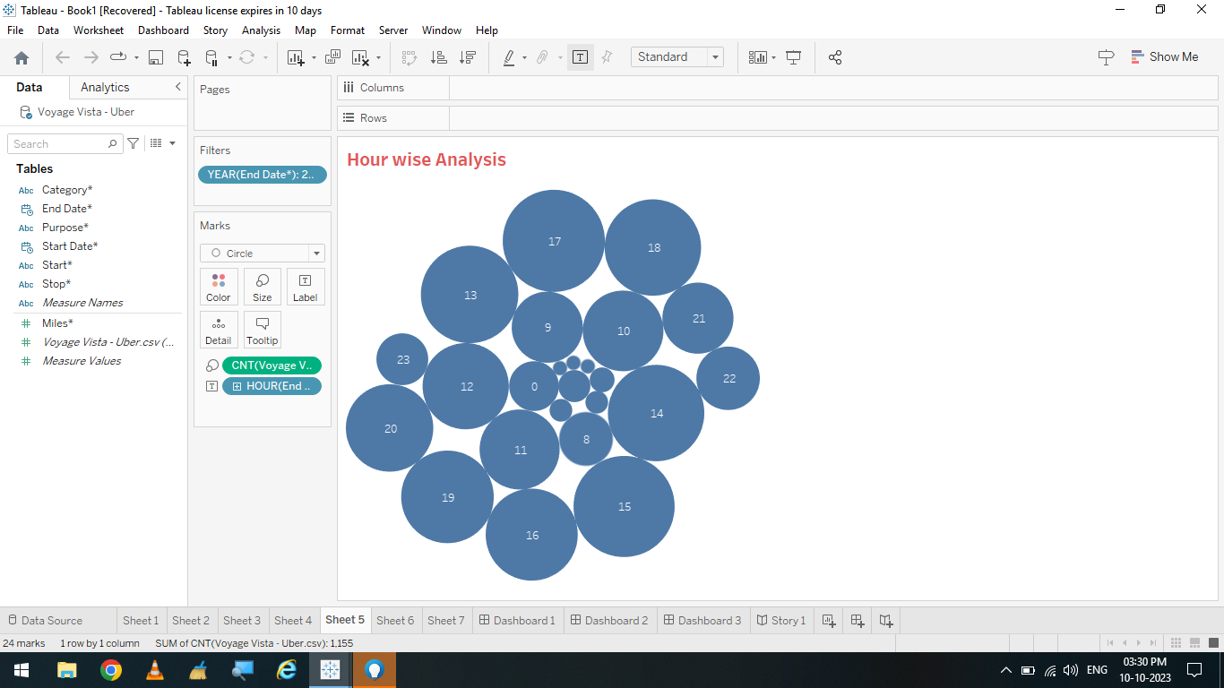

Activity 1.4: Miles covered Hour wise Analysis

Slide 9
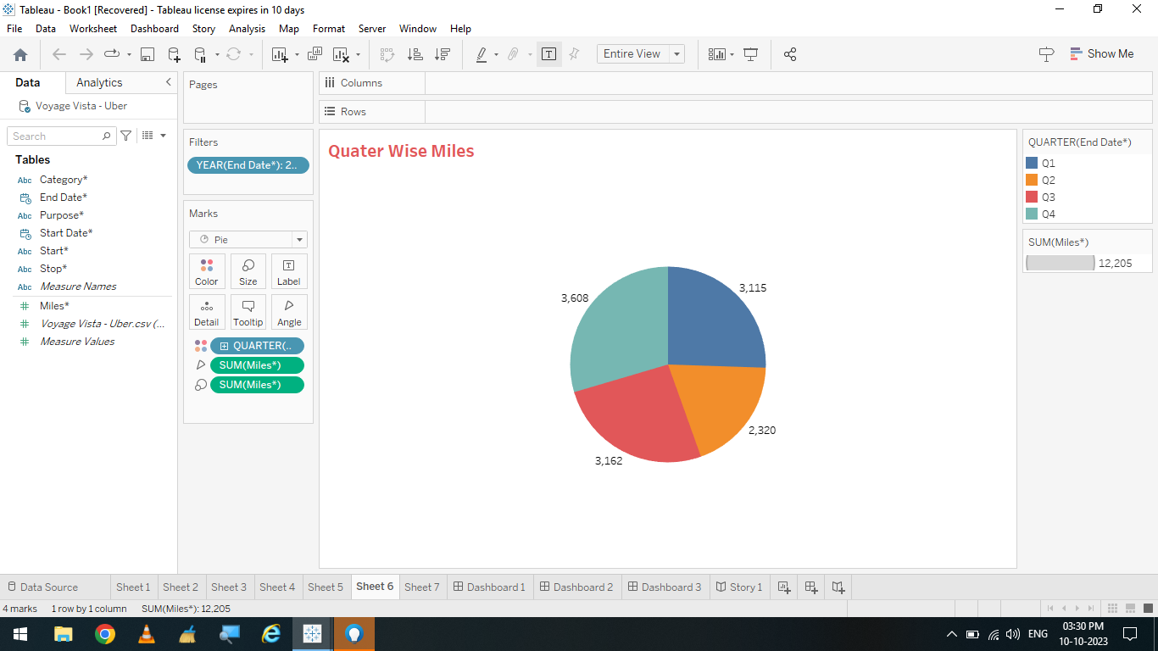
Activity 1.5: Quarter wise Uber Miles Analysis

Slide 10
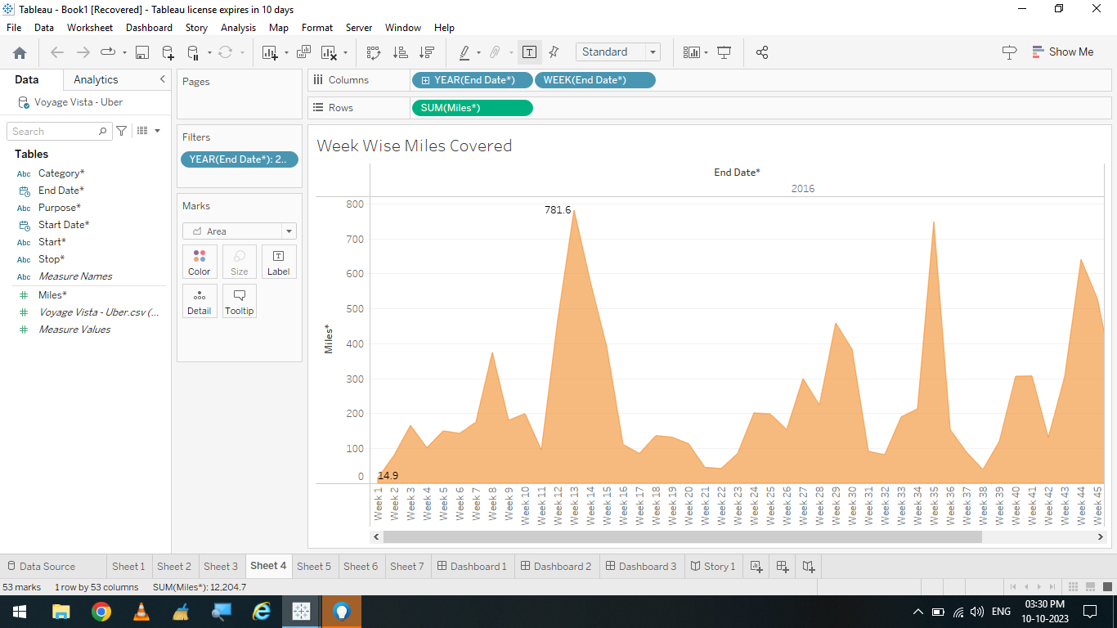
Activity 1.6: Week wise Uber Miles Analysis

Slide 11
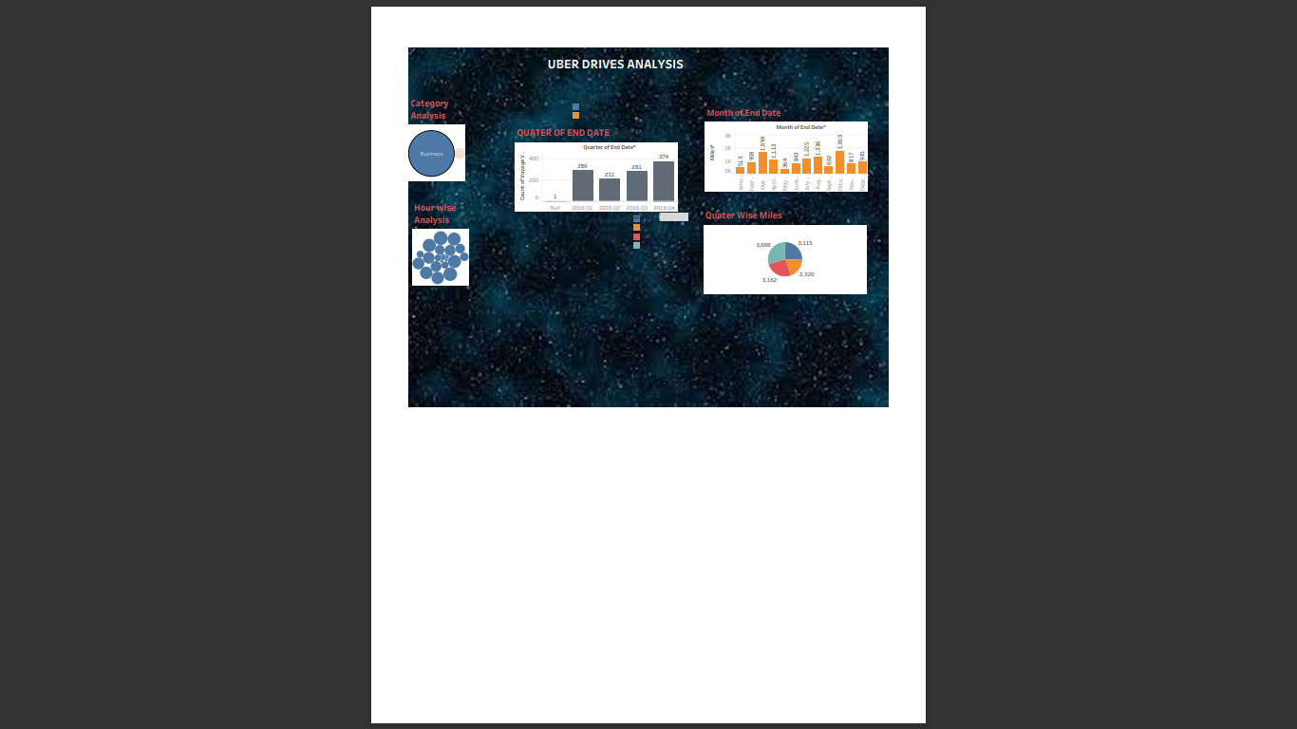
DASHBOARD
A dashboard is an information management tool that receives data from a linked database to provide data visualizations. It typically offers high-level information in one view that end users can use to answer a single question.
UBER DRIVE ANALYSIS

Slide 12
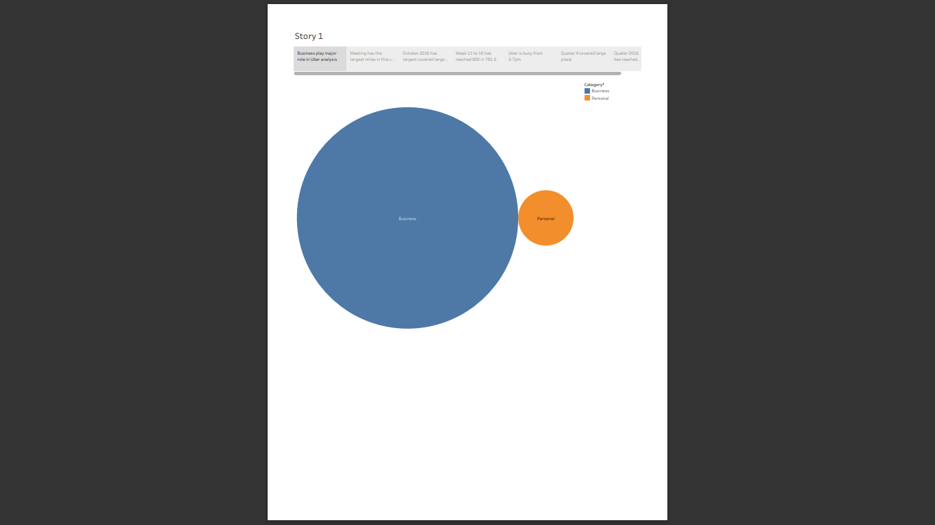
STORY
A data story is a way of presenting data and analysis in a narrative format, with the goal of making the information more engaging and easier to understand
ACTIVITY 1: NUMBER OF SCENES OF STORY
A storyboard is a visual representation of the data analysis process and it breaks down the analysis into a series of steps or scenes
UBER TRIPS

Slide 13
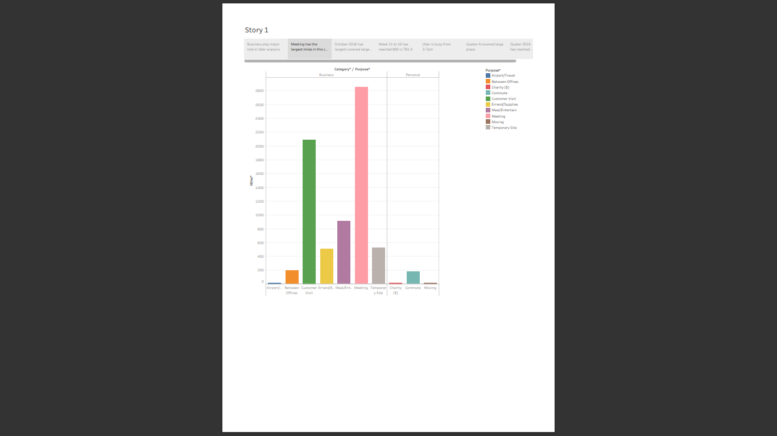
UBER TRIPS

Slide 14
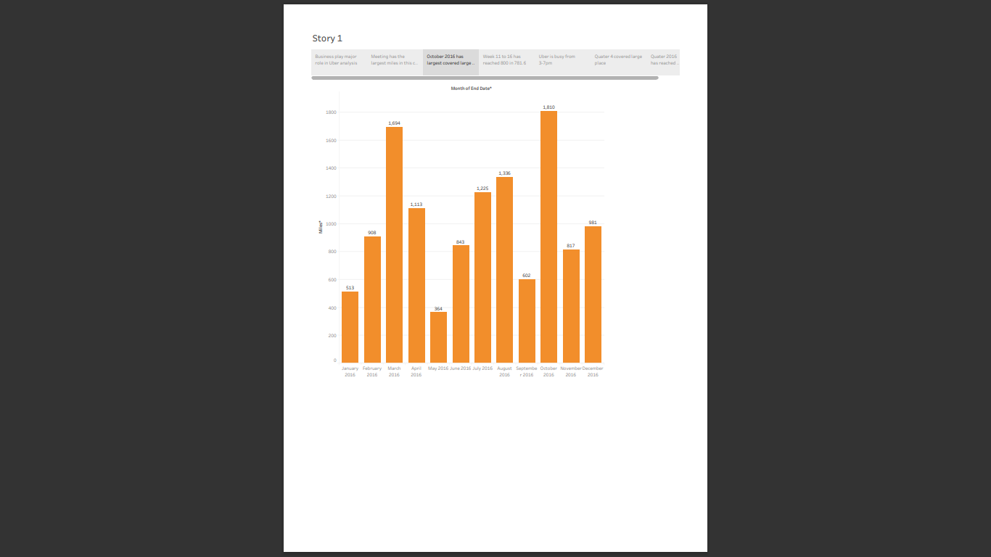
UBER TRIPS

Slide 15
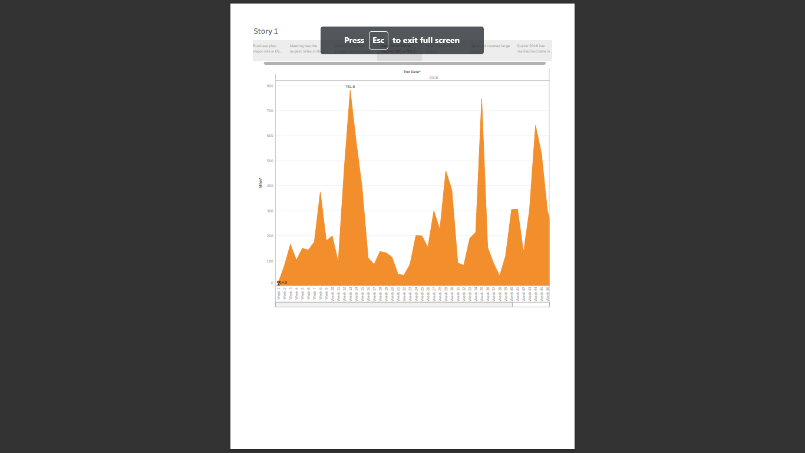
UBER TRIPS

Slide 16
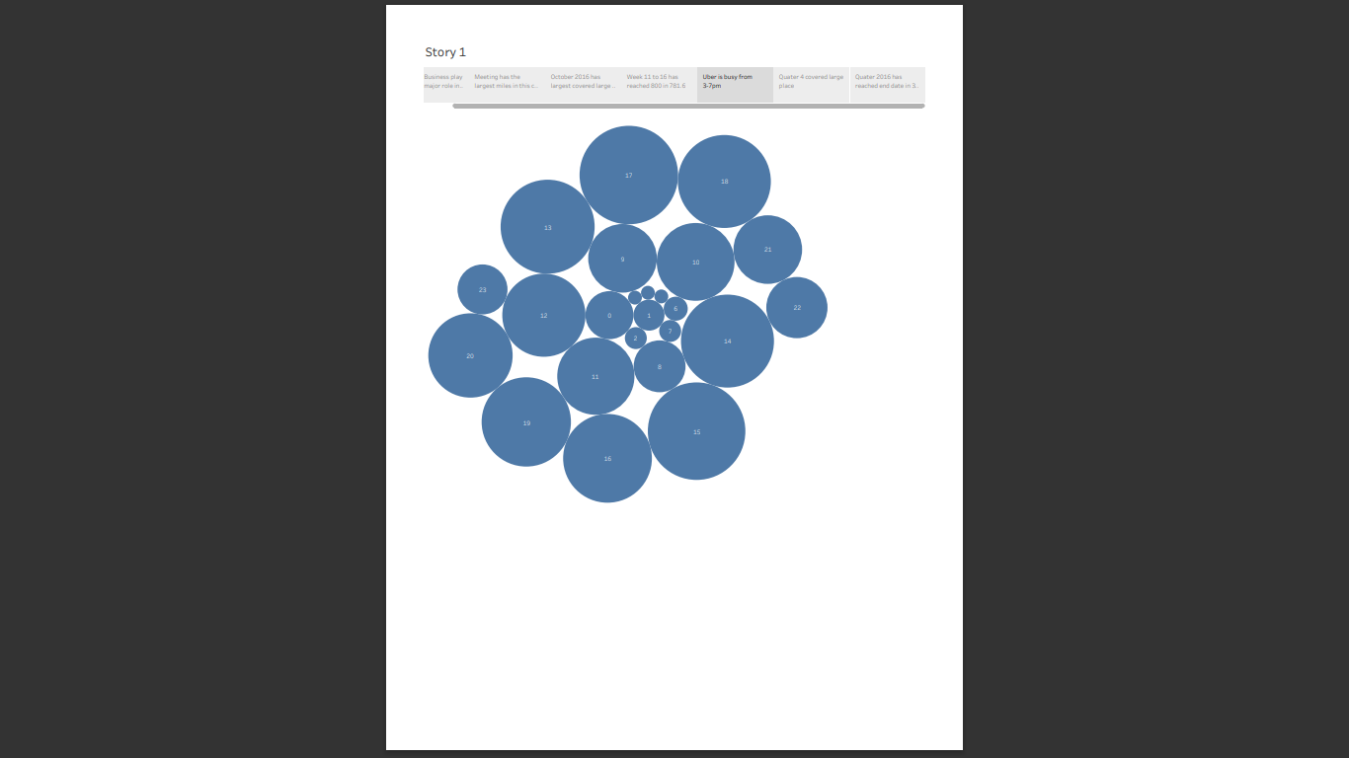
UBER TRIPS

Slide 17
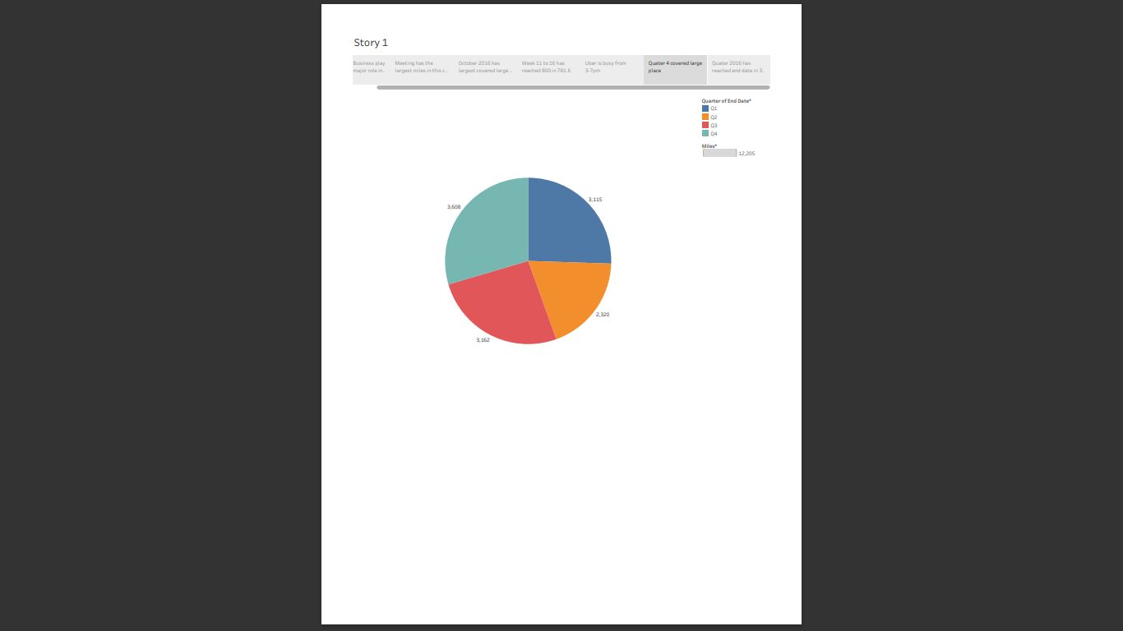
UBER TRIPS

Slide 18
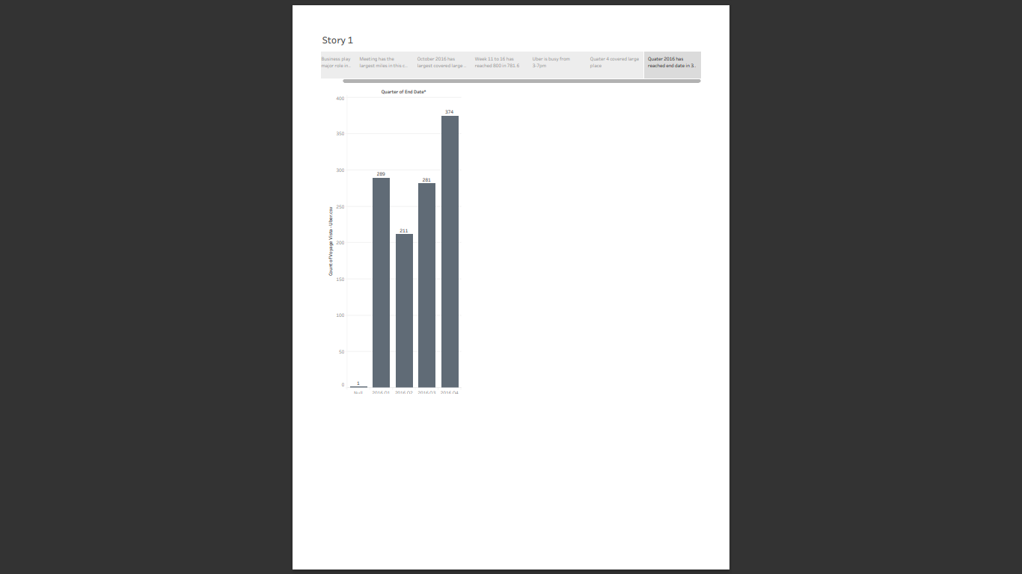
UBER TRIPS

Slide 19
ACTIVITY 1: UTILIZATION OF FILTERS

Slide 21
NUMBER OF VISUALISATION/GRAPHS
Bar graph showing Purpose od Uber with Miles covered
Bubble chart showing distribution of Miles with Category
Bar graph showing quarter with Number of Trips
Highlight Table shows Month wise Number of Trips
Bar graph showing Month with miles
Area Chart showing week with miles
Pie Chart showing Quarter with Miles
Bubble Chart showing Hour with Number of Trips

Slide 22
ADVANTAGES AND DISADVANTAGES
ADVANTAGES:
Convinience:
Uber offers a convenient and user-friendly way to look rides. Users can request a ride with a few taps on their smartphones, eliminating the need to hail a taxi or wait for public transportations.
Availability:
Uber operates in many cities and regions, providing riders with access to transportation options even in areas where traditional taxis may be scare.

Slide 23
Driver Income:
Uber provides flexible earning opportunities for drivers who can choose when and how much they want to work.
Driver ratings:
Uber allows riders to rate drivers and provide feedback, which can lead to better service quality and driver accountability.
Cashless Transactions:
Uber transactions are cashless, with payments made through the app using credit cards or digital wallets, eliminating the need for physical cash.

Slide 24
DISADVANTAGES:
Surge Pricing:
During peak times or high demand, Uber may implement surge pricing, significantly increasing the cost of rides, which can be frustrating for riders.
Safety Concerns:
While Uber has implemented safety features, incidents involving rider/driver safety occurred, raising concerns about the screening and monitoring of drivers.
Accessibility:
Uber may not be accessible to everyone, particularly those without smartphones or internet access.
Environmental Impact:
The proliferation of ride-sharing services like uber has raised concerns about increased traffic congestion and carbon emissions in some cities.
Lack of Employee Benefits:
Uber classifies its drivers as independent contractors, which means they do not receive benefits like health insurance, retirement contributions, or paid time off.

Slide 25
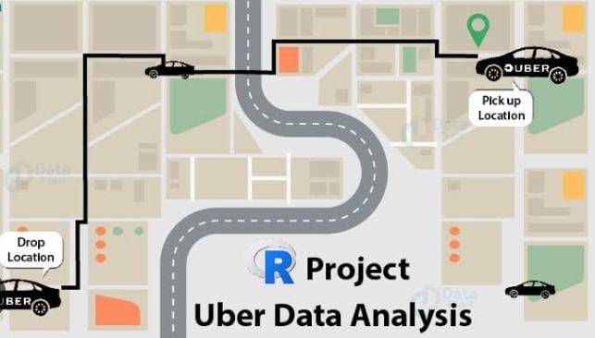
CONCLUSION
In this project, we analysis UBER EXPEDITIONARY ANALYSIS and explain the concept of UBER TRIPS. This analysis can help Uber drivers decide where to focus their driving efforts for maximum efficiency and profitability. We also give a brief overview of the Uber Trips and to find unknown pattern in the Uber Drives dataset.

Slide 26
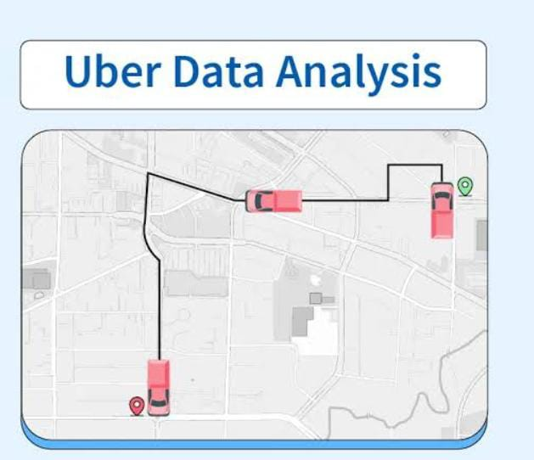
FUTURE SCOPE
Cheaper cars by buying used
Less expensive hybrid vehicles
More accurate GPS technology
Discount rates for multi-hours bookings
Pay premium for on demand service

Slide 27


